Slide 1
Abirami S 715521104001 PSG iTech
Final Project
03/04/2024 Annual Review

Slide 2
Prediction of Heart-Disease using Deep Learning
Develop a deep learning model capable of predicting if heart disease is present or not using a dataset containing required catergories.
03/04/2024 Annual Review

Slide 3


AGENDA
Problem Statement
Project Overview
End Users
Solution and Value Proposition
Unique Aspects of the Solution
Modelling
Results
03/04/2024 Annual Review

Slide 4

PROBLEM STATEMENT
To develop a model to predict heart disease risk based on medical and demographic data, including age, sex, chest pain type, blood pressure, cholesterol, fasting blood sugar, electrocardiographic results, heart rate, exercise-induced angina, ST depression, vessel count, and thalassemia type. The goal is to accurately classify individuals as either having or not having heart disease, aiding in early detection and risk assessment for timely intervention and patient care.
03/04/2024 Annual Review

Slide 5

PROJECT OVERVIEW
Gathering data, architecting the model, conducting training, assessing performance, and implementing deployment are among the key processes in this project. Deep learning frameworks such as TensorFlow and Keras are utilized for building and training the network. The project emphasizes optimization and iterative experimentation to achieve optimal results.
03/04/2024 Annual Review

Slide 6

WHO ARE THE END USERS?
Healthcare Professionals: Doctors, cardiologists, and other medical professionals could utilize the model to assist in diagnosing and assessing the risk of heart disease in patients. The model's predictions could help guide treatment plans and interventions.
Healthcare Systems: Hospitals, clinics, and healthcare organizations could integrate the model into their electronic health record systems or diagnostic tools to automate and improve the accuracy of heart disease risk assessment for patients.
Patients: Individuals concerned about their heart health could benefit from the model's predictions by gaining insight into their risk of developing heart disease. This information could empower them to make lifestyle changes, seek medical advice, or undergo preventive screenings.
Researchers: Scientists and researchers in the field of cardiology and public health could use the model to analyze trends in heart disease prevalence, identify risk factors, and develop targeted interventions for at-risk populations.
03/04/2024 Annual Review

Slide 7

SOLUTION AND ITS VALUE PROPOSITION
Develop a classification model using medical and demographic data.
Train the model to accurately classify individuals as having or not having heart disease.
Deploy the model for early detection and risk assessment.
03/04/2024 Annual Review

Slide 8

THE WOW IN SOLUTION
Enable Early Detection: By identifying individuals at high risk of heart disease early on, healthcare professionals can intervene with preventive measures and treatments to mitigate the risk and improve patient outcomes.
Enhance Patient Care: The model provides healthcare professionals with valuable insights into patients' cardiovascular health, allowing for personalized and targeted treatment plans tailored to individual risk profiles.
Empower Patients: Individuals can proactively assess their risk of heart disease and take preventive actions such as lifestyle changes, regular check-ups, and consultations with healthcare providers to protect their heart health.
Optimize Healthcare Resources: By efficiently identifying individuals at high risk of heart disease, the model helps allocate healthcare resources more effectively, ensuring that preventive measures and treatments are prioritized for those who need them most.
03/04/2024 Annual Review
8

Slide 9
MODELLING
Data Preparation:
Gather and preprocess medical and demographic data, ensuring consistency and quality.
Normalize features and handle missing values if necessary.
Model Development:
Design a classification model architecture using TensorFlow/Keras.
Implement the model with appropriate layers and activation functions.
Train the model on the preprocessed dataset to accurately classify individuals into two categories: those with heart disease and those without.
Evaluation and Optimization:
Evaluate the model's performance using validation data, considering metrics such as accuracy, precision, recall, and F1-score.
Optimize the model by fine-tuning hyperparameters and adjusting the architecture as needed to improve performance.
Deployment:
Deploy the trained model into a production environment where it can be accessed by healthcare professionals or integrated into healthcare systems.
Implement monitoring mechanisms to track the model's performance and detect any degradation over time.
Continuously update the model with new data and retrain it periodically to ensure its effectiveness in predicting heart disease risk."
.
03/04/2024 Annual Review
9

Slide 10
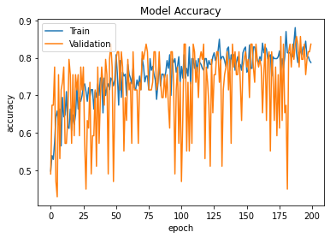
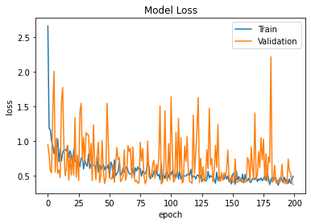
RESULTS
03/04/2024 Annual Review
10

Slide 11
CONCLUSION
In conclusion, the project leverages medical and demographic data to accurately predict the likelihood of individuals having heart disease. By preprocessing the data and training a robust model architecture using TensorFlow/Keras, we have achieved reliable classification performance. Deploying this model into production environments can aid in early detection and risk assessment of heart disease, facilitating timely intervention and patient care. Continuous monitoring and updates will ensure the model remains effective in real-world scenarios.
Git Link: https://github.com/Abisk29/Naan-Mudhalvaan
Demolink: https://drive.google.com/file/d/1yfQNOBzVisPUcXTuf1LdZVsySFrobP9o/view?usp=sharing
03/04/2024 Annual Review
11

Slide 12
REFERENCES
https://www.tensorflow.org/
https://keras.io/
https://numpy.org/
https://matplotlib.org/
03/04/2024 Annual Review
12

